Slide 1
Vibration Triggered Security Surveillance System Design
Diptanu das
12ee01033

Slide 2
Introduction
Necessity of Security Surveillance system is the insecurity and crime constitute faced by our immediate society today.
Even with the introduction of alarm systems utilizing infrared motion detection, light (photo) sensitive electronic devices, there is still problem of false alarm which needs to be minimized.
In order to effectively increase the level of security and to avoid false alarms, a vibration triggered security system is required which should be cost effective.

Slide 3
Objective
The objective was to implement such a system that if there were any vibration sensed on the surface of a protected material or protected area (door or entrance of a living area) the user will be informed through internet.
Here, informing the user has been done by sending a mail to user by informing the vibration intensity; so that the user can easily identify the nature of vibration; whether someone is just knocking the door or some intruder is trying to enter to the unauthorized area.

Slide 4
Design and Implementation
The system design was implemented in three steps.
First, to develop algorithm from the fundamentals of physics to detect vibration.
Second, to interface the required components and to embed the algorithm in Arduino (microcontroller used for this purpose).
Third, to interface the operating system with Arduino and sending mail using Mailgun transactional Email API Service.

Slide 5
Developing Algorithm
Basic definition of Vibration says, a body is said to vibrate when it describes an oscillating motion about a reference position.
The basic parameter used to measure vibration is the physical displacement of the body from the reference position.
In addition to displacement, the velocity and the acceleration of the body is also described.
The form and period of the vibration remain the same whether it is the displacement, velocity or acceleration. The main difference is that there is a phase difference between the amplitude time curve.

Slide 6
Parameter to detect vibration
The most important aspect in considering the parameter is that the acceleration measurements are weighted towards high frequency vibration components, so this parameter tends to be used where the frequency range of interest covers high frequencies.
In the same manner the displacement should be used as parameter for low frequency and velocity for high frequency vibration detection.
As the occurrence of low frequency vibration is basically caused by very slow and gradual movement of the body; mostly caused by wind (noise component). The displacement and velocity should not be considered as parameter for this particular system.

Slide 7
Components Required
Components required to design this particular step for this system is a acceleration sensing device and a micro controller to process the sensed input.
Here, the accelerometer model ADXL-335 has been used as acceleration sensing and measuring device and Arduino has been used as micro controller. These components has been choosen over other components because of their high performance and low cost.

Slide 8
Accelerometer (ADXL-335)
The ADXL-335 is a small, thin, low power, complete 3-axis accelerometer with signal conditioned voltage outputs.
It measures acceleration with a minimum full-scale range of -3g to +3g. It can measure the static acceleration of gravity in tilt-sensing application, as well as dynamic acceleration resulting from motion, shock, or vibration.

Slide 9
Arduino (UNO)
The Arduino (UNO R3) is a microcontroller board based on the Atmega328.
The Arduino has digital input/ output pins (some of them can be used as PWM outputs), analog input pins (no of pins depends on the Arduino model), a 16 MHz crystal oscillator, a USB connection, a power jack, an ICSP header, and a reset button.
The standard arduino runs at 16 MHz, so the arduino completes 16,000,000 clock cycles per second.

Slide 10
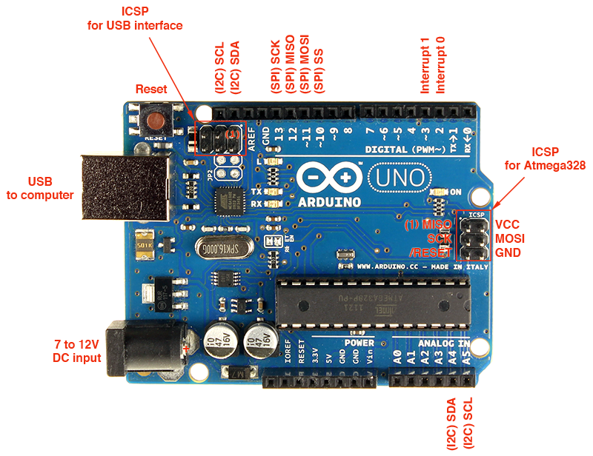
Diagram of a Arduino UNO R3 Model.

Slide 11
Algorithm
The accelerometer ADXL335 not only measures the dynamic acceleration of a body but also it measures the static acceleration of gravity which should be deducted from the measured value.
Here, the change in acceleration has to be considered to detect sudden change in vibration.
the acceleration of a vibrating body is proportional to square of the frequency at which the body is vibrating, when the amplitude and phase is constant. This is the reason why acceleration is used as a parameter for the detection of high frequency vibration detection.

Slide 12
Flow Chart
Initialize: ax1=0; ax2=0
while true
ax1 = sense_pin_x()
no
dx = abs(ax1-ax2)
ax2 = ax1
If
dx > th
yes
Vibration Detected

Slide 13
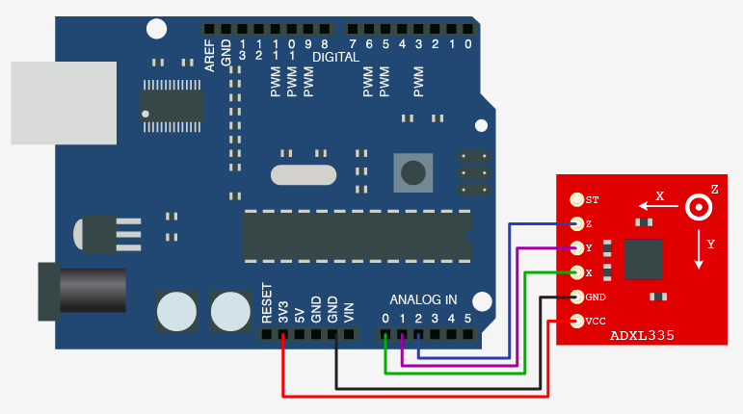
Interfacing components and Embedding the Algorithm
Arduino Pin Layout

Slide 14
Arduino Code
Click here to see the code

Slide 15
Interfacing Operating System with Arduino and Sending Mail
Hardware Used: Raspberry PI B+ Model
Operating System used: Raspbian
Programing Language used: Python
Modules used: PySerial, Datetime, Requests
MailGun: Transactional email API Service

Slide 16
Hardware used: Raspberry PI
Raspberry PI with Raspbian installed. The Raspberry Pi is a series of credit card–sized single-board computers developed in the UK by the Raspberry Pi Foundation with the intention of promoting the teaching of basic computer science in schools.
To make this project cost effective and open sourced, instead of using windows based operating system and computers, Raspberry PI B+ Model has been used. This system can be implemented in any windows based operating system.

Slide 17
Operating System Used: Raspbian
Raspbian: Raspbian is a free operating system based on Debian optimized for the Raspberry Pi hardware. An operating system is the set of basic programs and utilities that make Raspberry Pi run.
Windows operating system can be used for the same purpose if the hardware is a general PC instead of Raspberry PI.

Slide 18
Python as Programing Language
Python 2.7.10: Python is a widely used general-purpose, high-level programming language. Its design philosophy emphasizes code readability, and its syntax allows programmers to express concepts in fewer lines of code than would be possible in languages such as C++ or Java. The language provides constructs intended to enable clear programs on both a small and large scale.
Python 2.7.10 is supported by most of the operating systems and pre-installed package for most of the Linux based operating System.

Slide 19
Python Modules used: PySerial, Datetime, Requests
PySerial: PySerial is a library which provides support for serial connections ("RS-232") over a variety of different devices: old-style serial ports, Bluetooth dongles, infra-red ports, and so on. It also supports remote serial ports via RFC 2217 (since V2.5).
Datetime Module: The datetime module supplies classes for manipulating dates and times in both simple and complex ways. While date and time arithmetic is supported, the focus of the implementation is on efficient attribute extraction for output formatting and manipulation.
Requests: Requests is a Python HTTP library, released under the Apache2 License. The goal of the project is to make HTTP requests simpler and more human-friendly. The current version is 2.6.0.

Slide 20
Mailgun: Transactional Email API Service for Developers
A set of powerful APIs that allows user to send, receive and track email from application effortlessly for Python, Ruby, PHP, C#, Node.js or Java.
Python Code for sending mail using Mailgun

Slide 21
Interfacing Operating Sytem with Arduino and to mail on vibration detection
1. The serial port is interfaced with python IDLE using PySerial module.
2. Vibration has been detected when a particular key string appears in the arduino serial port. Here, the key string is “Vibration”.
3. After detecting vibration the mail sending function (using Mailgun API service, requests module, datetime module) sends mail to the registered email address conveying the intensity of the vibration detected at a particular time.
Python code used in the project to interface with Arduino and to send mail on Vibration Detection

Slide 22
Future Work
The security system can be further developed by integrating PIR sensor based system or photo sensor based system with this vibration triggered system.
By interfacing with web-cams the system can take snap shots while triggered by vibration. The snap shot can be further processed for face detection and face recognition (image processing) to ensure there is no intruder. The snap shot can be mailed using same procedure.

Slide 23
Conclusion
It can be concluded that the sole aim of carrying out the design, analysis and implementation of a simple and reliable vibration sensitive security system has been designed.
Although the system should be designed for general purpose, for the sake of time, the help of Mailgun API Service has been taken account.
The designed system was tested and found to be working to specifications and predictions.

Slide 24
References
[1] “Measuring Vibration” - by Brüel & Kjær
[2] “A Simple and Relianble Touch Sensitive Security System” - by Adamu Murtala Zungeru, Jonathan Gana Kolo and Ijarotimi Olumide
[3] https://en.wikipedia.org/
[4] https://wiki.python.org/
[5] http://playground.arduino.cc/Interfacing/Python
[6] http://www.mailgun.com/
[7] https://www.raspberrypi.org/
[8] https://www.raspbian.org/

Slide 25
Thank You.

